Slide 1
The Role of TP53 Co-Mutations in Breast Cancer Patient Survival
Kailin Liu, Chloe Liu, Colin Yeo

Slide 2
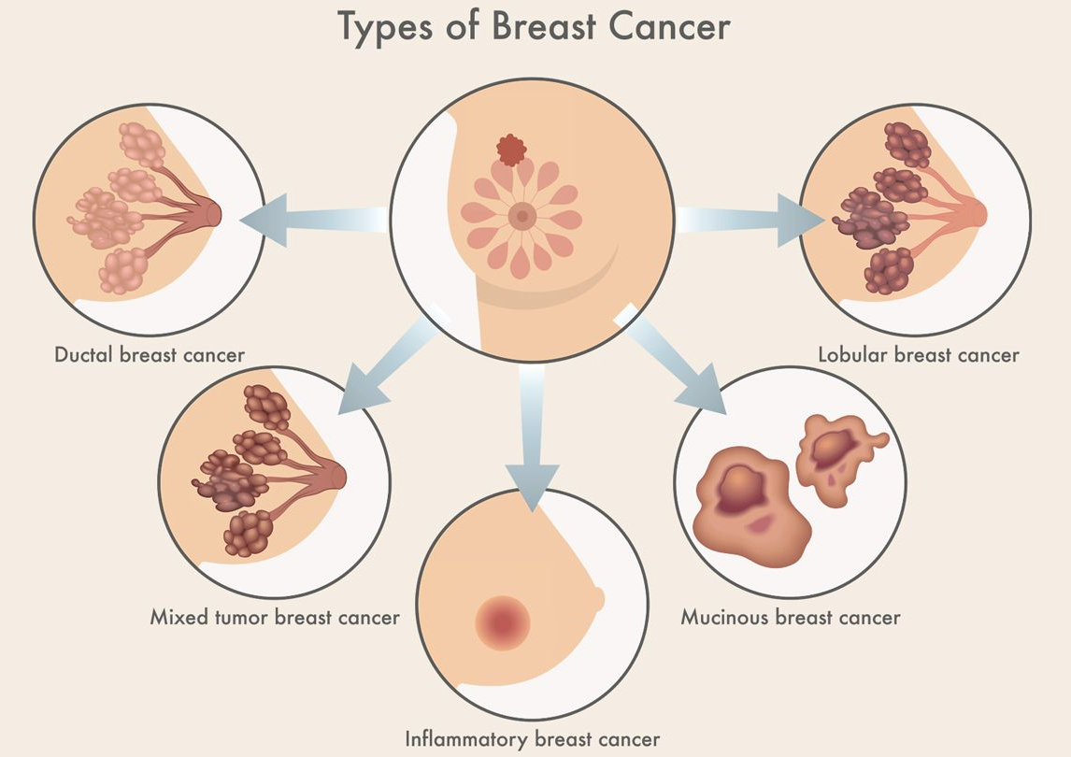
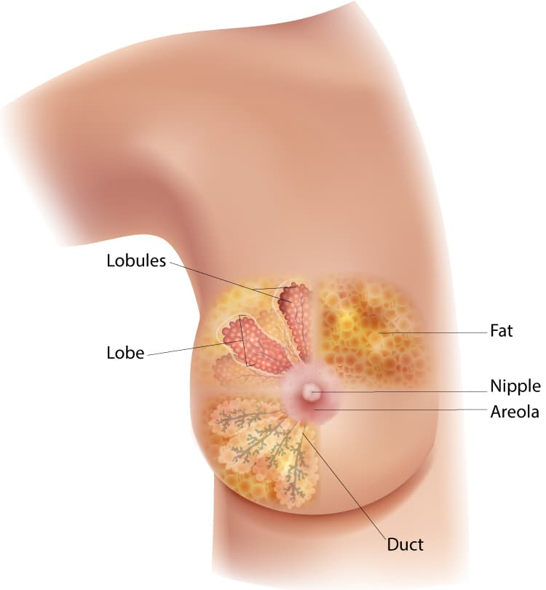
Introduction - Breast Cancer
Notes:
Kailin
Represents about 22.9% of all female cancers
One in eight women developing breast invasive carcinoma in their lifetime
5-year survival of this disease hovers around 90%, and 10-year survival is about 85%

Slide 3
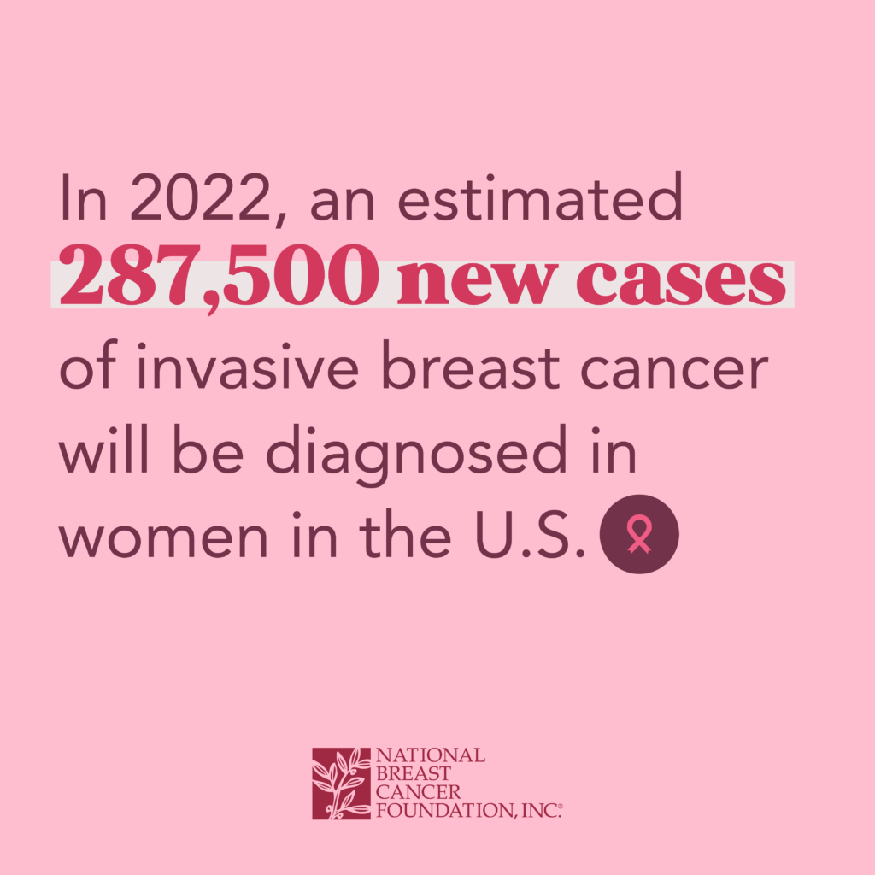

Introduction - Breast Cancer Statistics
Notes:
Kailin
Represents about 22.9% of all female cancers
One in eight women developing breast invasive carcinoma in their lifetime
5-year survival of this disease hovers around 90%, and 10-year survival is about 85%

Slide 4


Introduction - Datasets
Notes:
Kailin

Slide 5
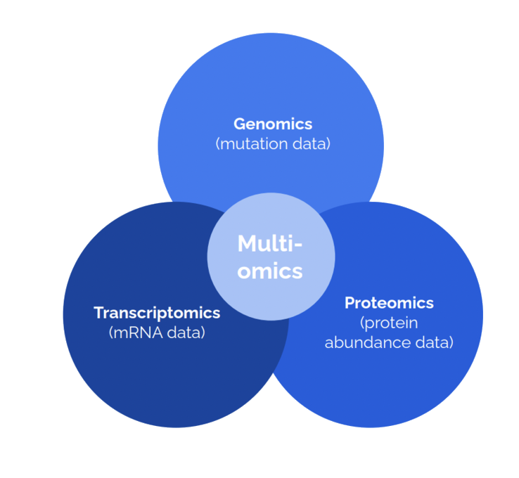
Introduction - Multi-omic Data Analysis
Clinical data
TCGA
CPTAC
Notes:
Kailin
Proteomic (protein makeup), genomic (DNA), and transcriptomic
Highlight patterns in genetic mutations and disease outcomes
Allowing clinicians to make more informed choices based on an individual’s biology

Slide 6
Research Question:
How does TP53 co-mutation influence survival in breast cancer patients and interact with other genes/protein production?
Notes:
Colin

Slide 7
Methods
R
TCGA (~1100 patients)
BiocManager, Summarized Experiment
Maftools, ggplot2, survival, survminer
Python
CPTAC (122 patients)
Numpy, Pandas, Scipy, Matplotlib, Seaborn
Notes:
Kailin & Chloe

Slide 8
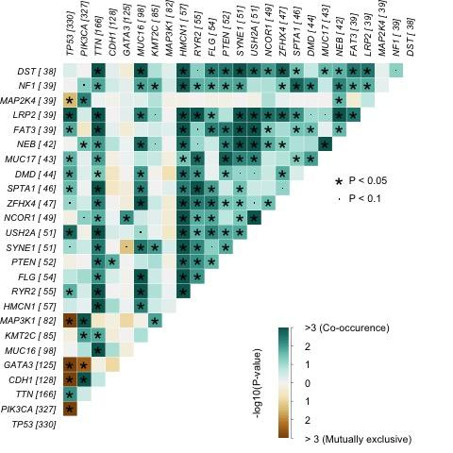
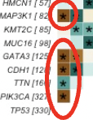
4 Genes Show Mutual Exclusivity with TP53 (Fig 1)
Somatic Interaction Plot that highlights 4 mutually exclusive genes with TP53.
Notes:
Kailin

Slide 9
Our 4 Chosen Genes
MAP3K1 (cell migration/survival), GATA3 (cell development/function), CDH1 (tumor suppression), PIK3CA (cell growth)
TP53 & GATA3 implicated in early onset breast cancer (Grote et al., 2021)
TP53 & CDH1 involved in familial breast cancer (Rahim et al., 2022)

Slide 10
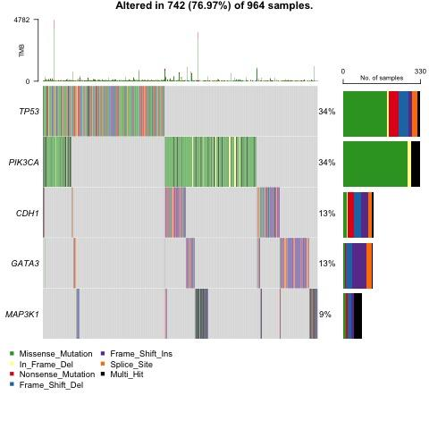
Oncoplot Shows Slight Overlap between Genes (Fig 2)
Key Takeaways:
Certain genetic mutations are caused disproportionately by one type of mutation
The number of overlaps between the gene mutations is minor
Notes:
Chloe

Slide 11
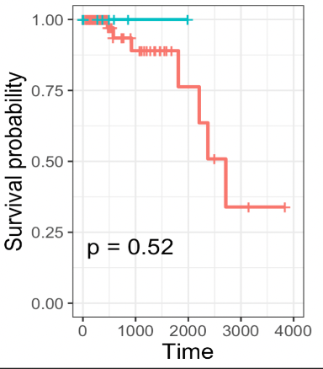
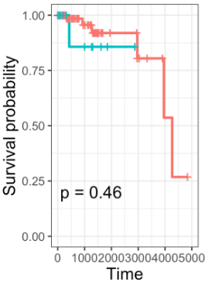
KM Plot Shows Higher Survival Probability for TP53+/CDH1+ and TP53+/MAP3K1+ Patients (Figs 3-4)
RED = TP53-
BLUE = TP53+
(Days)
(Days)
(Days)
MAP3K1 (TP53-: 113; TP53+: 9)
CDH1 (TP53-: 123; TP53+: 11)
Notes:
Chloe

Slide 12
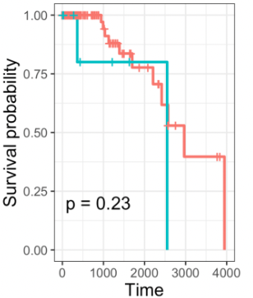
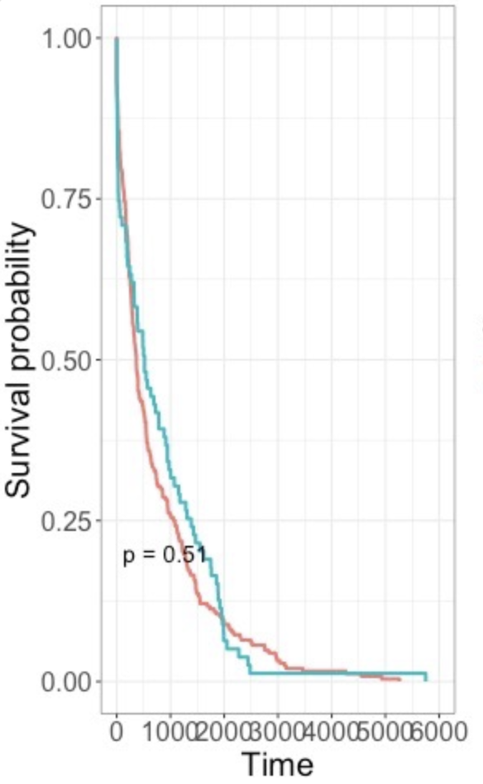
KM Plot Shows Non-Differential Survival for GATA3+ and PIK3CA+ Patients (Figs 5-6)
RED = TP53-
BLUE = TP53+
(Days)
(Days)
(Days)
GATA3 (TP53-: 118; TP53+: 9)
PIK3CA (TP53-: 289; TP53+: 79)

Slide 13
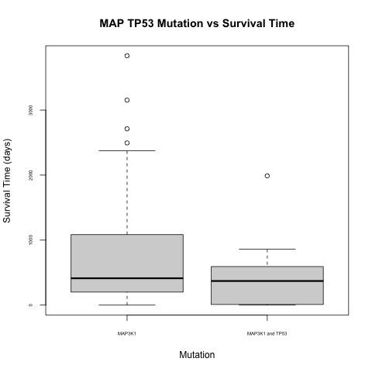
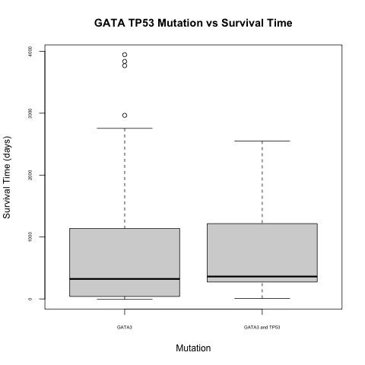
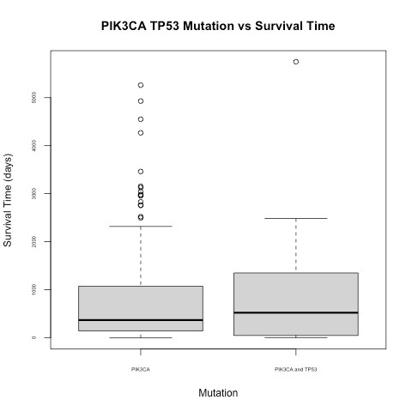
Survival Time Comparable for 3 Genes (Figures 7, 9, 10)
Left = Single Mutation
Right = TP53 Co-mutation
Notes:
Chloe
average survival time of individuals with mutations in both TP53 and CDH1 genes survived longer, on average, post-diagnosis
TP53 and CDH1 are both responsible for tumor suppression, and one would expect that having both of these genes mutated, rather than just one, is detrimental to an individual’s survival

Slide 14
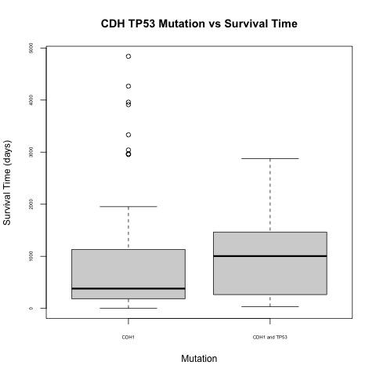
CDH1/TP53 Co-Mutation → Longer Survival (Fig 8)
CDH1
Left = Single Mutation
Right = TP53 Co-mutation

Slide 15
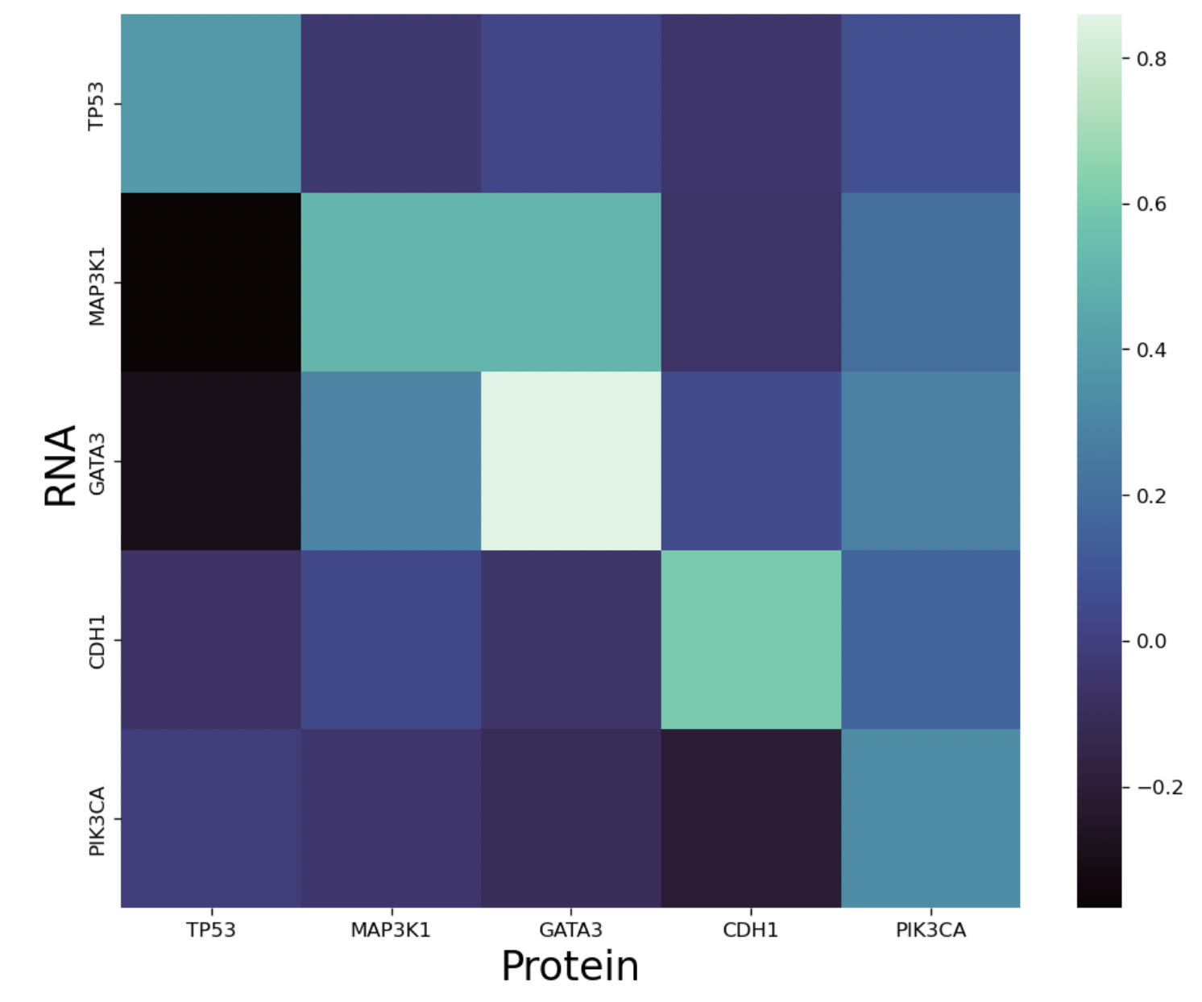
RNA/Protein Expression Heatmap (Fig 11)
Negative Relationship between TP53 Protein & GATA3/MAP3K1 RNA
Notes:
Chloe

Slide 16
Notable Takeaways
TP53+/CDH1+ patients survival time > TP53-/CDH1+ patients in our dataset
These mutations are correlated with increase breast cancer risk (Shabnaz et al., 2015)
P > 0.05 for this finding, suggests potential statistical weakness
Low presence of TP53 protein correlated with high expression of GATA3, MAP3K1 genes/RNA
Recent article (ovarian cancer) suggests GATA3 may cause apoptosis of TP53-producing cells (El-Arabey et al., 2022)
Notes:
Colin

Slide 17
Future areas of study
Consider the interactions between other genes (outside of the genes chosen for this study)
Repeat this study on a bigger dataset (i.e. TCGA only contained ~1100 patients), might address the statistical significance issues
Notes:
Colin

Slide 18
Why does this matter?
Clinicians may push for more individualized treatments for patients with various combinations of mutated genes
Understanding co-mutations’ influence on survival may provide families with a loved one’s prognosis
Notes:
Colin

Slide 19
Works Cited
Donepudi, M., Kondapalli, K., Amos, S. & Venkanteshan, P. (2014). Breast Cancer Statistics and Markers. J Cancer Res Ther. 10(3): 506-511. DOI: 10.4103/0973-1482.137927.
El-Arabey A., Denizli, M., Kanlikilicer, P., Bayraktar, R., Ivan, C., Rashed, M., Kabil, N., Ozpolat, B.,vCalin, G., Salama, S., Abd-Allah, A., Sood, A. & Lopez-Berestein, G. (2020). GATA3 as a master regulator for interactions of tumor-associated macrophages with high-grade
serous ovarian carcinoma. Cellular Signaling 68: 109539.
Fuchs, S., Adler, V., Pincus, M. & Ronai, Z. (1998). MEKK1/JNK signaling stabilizes and activates p53. Proc. Natl. Acad. Sci. USA 95: 10541-10546.
Grote, I., Bartels, S., Kandt, L., Bollmann, L., Christgen, H., Gronewold, M., Raap, M., Lehann, U., Gluz, O., Nitz, U., Kuemmel, S., Eulenburg, C., Braun, M., Aktas, B., Grischke, E., Schumacher, C., Luedtke-Heckenkamp, K., Kates, R., Wuerstlein, R., …Kreipe, H. (2021). TP53
mutations are associated with primary endocrine resistance in luminal early breast cancer. Cancer Medicine 10(23): 8581-8594. DOI: 10.1002/cam4.4376.
Rahim, A., Jan, A., Ali, J., Khuda, F., Muhammad, B., Khan, H., Shah, J. & Akbar, R. (2022). Association of ATM, CDH1 and TP53 genes polymorphisms with familial breast cancer in patients of Khyber Pakhtunkhwa, Pakistan. African Health Sciences 22(3). DOI
10.4314/ahs.v22i3.17
Rosenthal, E., Evans, B., Kidd, J., Brown, K., Gorringe, H., Orman, M. & Manley, S. (2017). Increased Identification of Candidates for High-Risk Breast Cancer Screening Through Expanded Genetic Testing. Journal of the American College of Radiology 14(4): 561-568.
Shabnaz, S., Ahmed, M., Islam, Islam, S., Islam, R., Al-Mamun, A., Islam, M. & Hasnat, A. (2016). Breast cancer risk in relation to TP53 codon 72 and CDH1 gene polymorphisms in the Bangladeshi women. Tumor Biology 37: 7229-7237. DOI: 10.1007/s13277-015-4612-7.
Suravajhala, P., Kogelman, L. & Kadarmideen, H. (2016). Multi-omic data integration and analysis using systems genomics approaches: methods and applications in animal production, health and welfare. Genetics Selection Evolution 48(38).

Slide 20
Questions?

